Slide 1
Cartesian Robot & Soft Actuator
David Camparmo

Slide 2
Summary of Soft Robotics
A subfield of robotics that focuses on the design, control, and fabrication of robots of comprised flexible materials.
Though rigid body robots can have soft components such as shock absorbing joint, soft robotics generally refers to machines that are predominately or completely soft

Slide 3
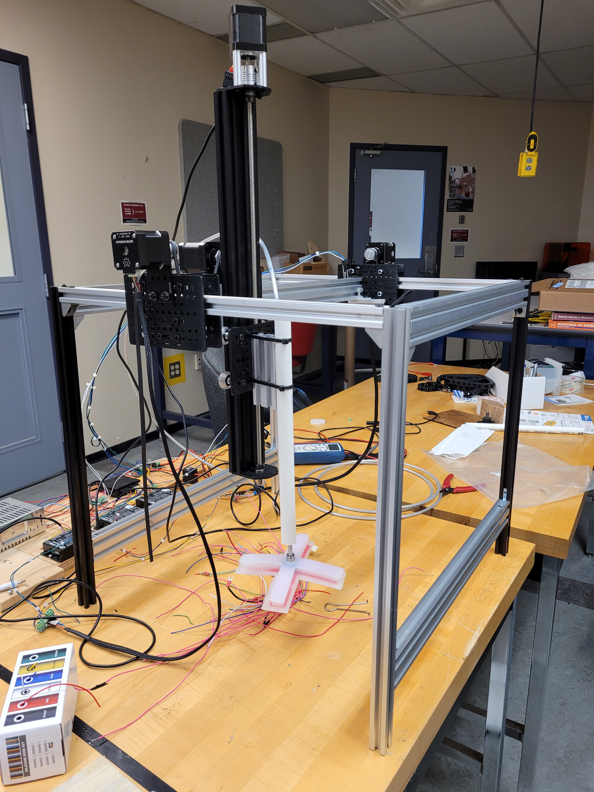
Semester Goals
Build a soft actuator
Add Limit sensors to robot
Implement a pneumatic system to control the actuator.
Create a program to manually control the robot
Refine the user interface to be easier to use

Slide 4
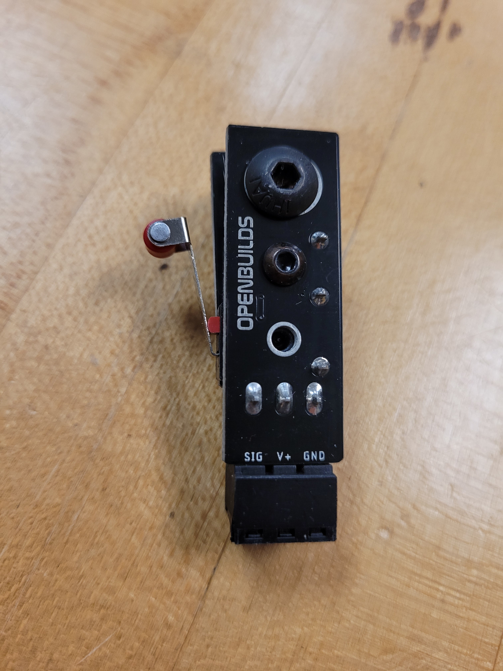
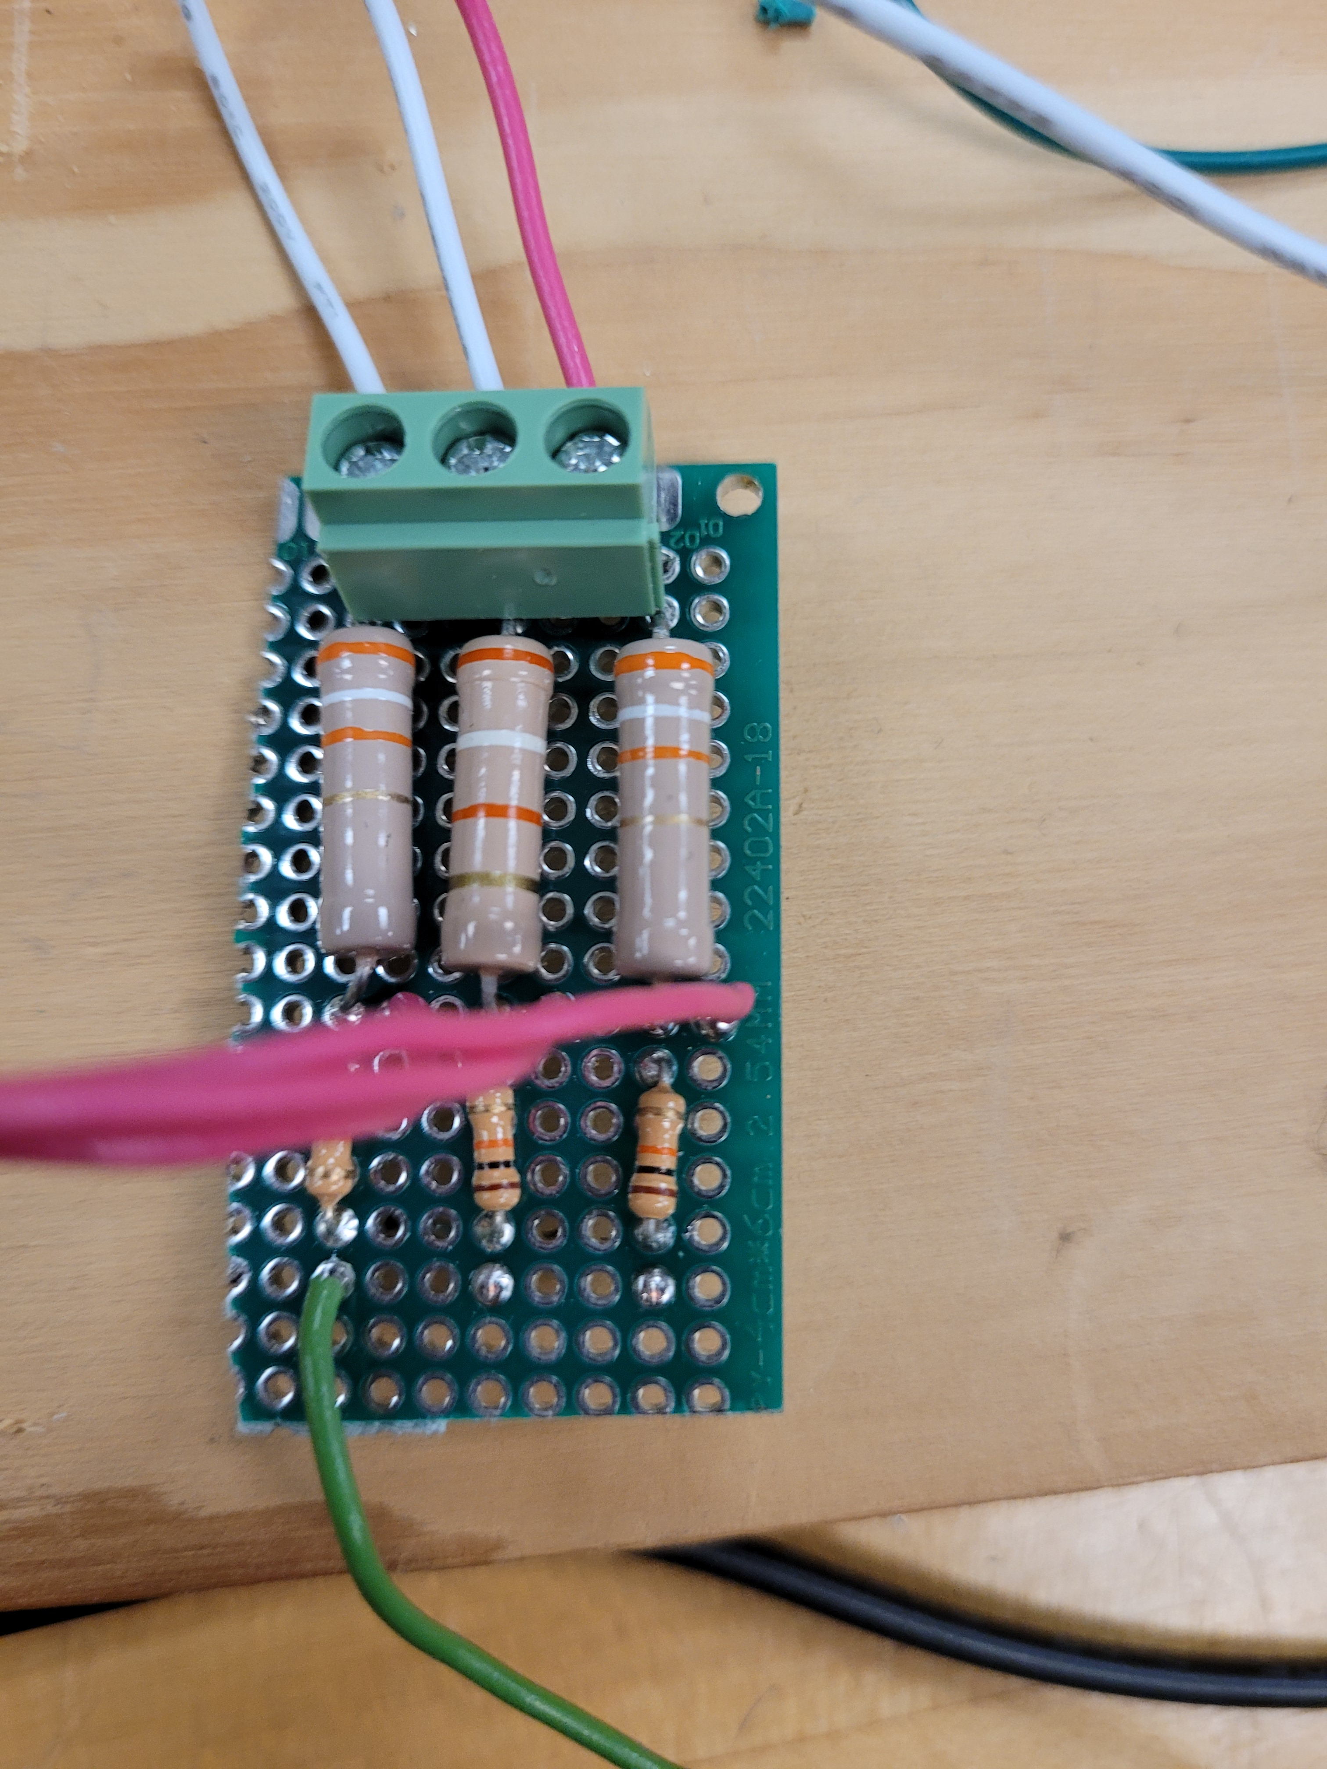
Limit sensors

Slide 5
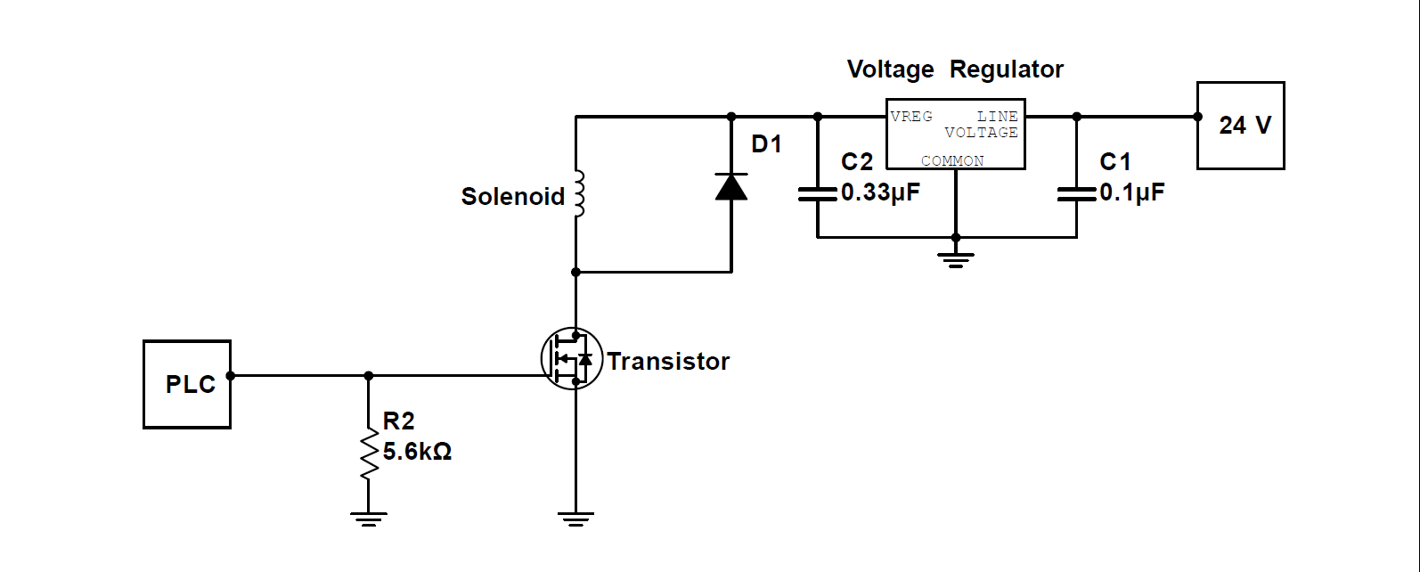
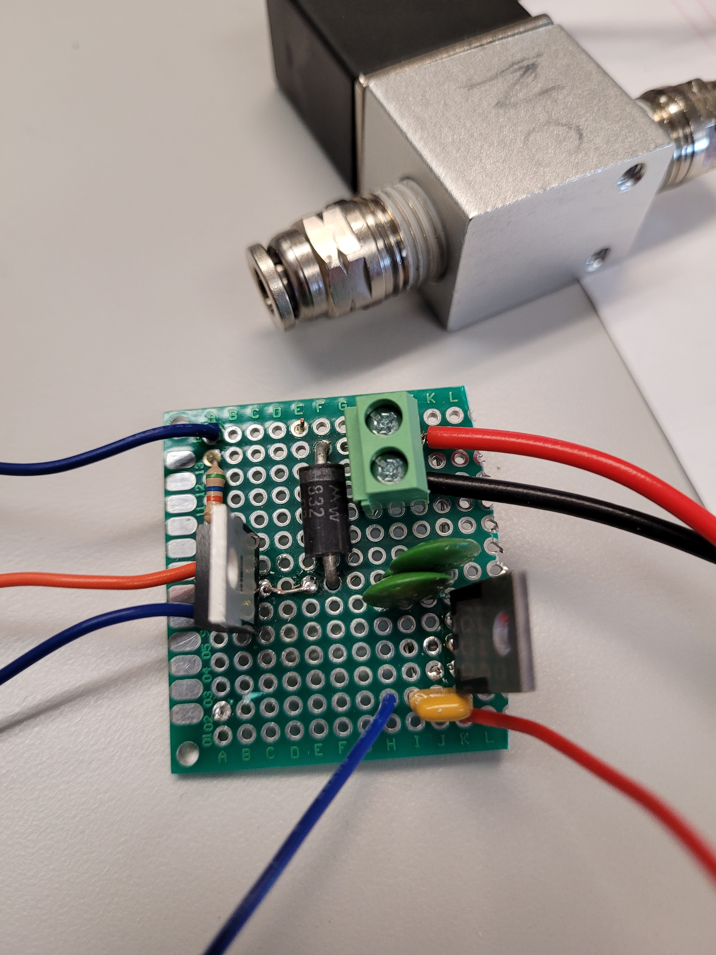
Pneumatic Control

Slide 6
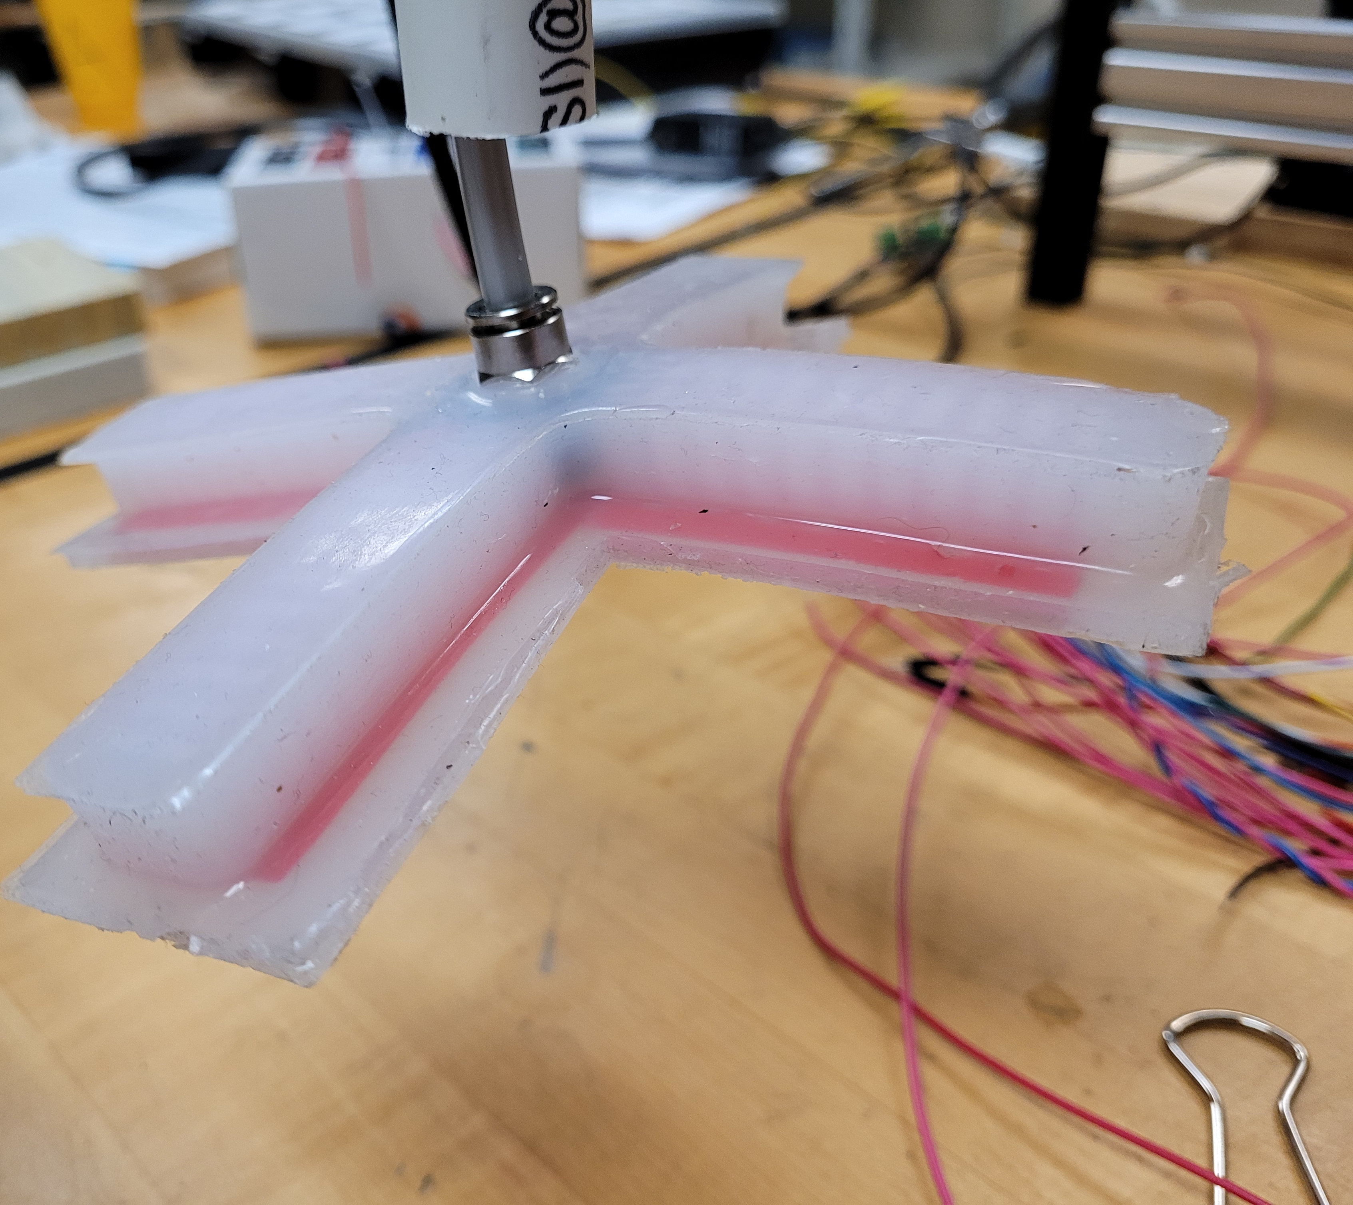
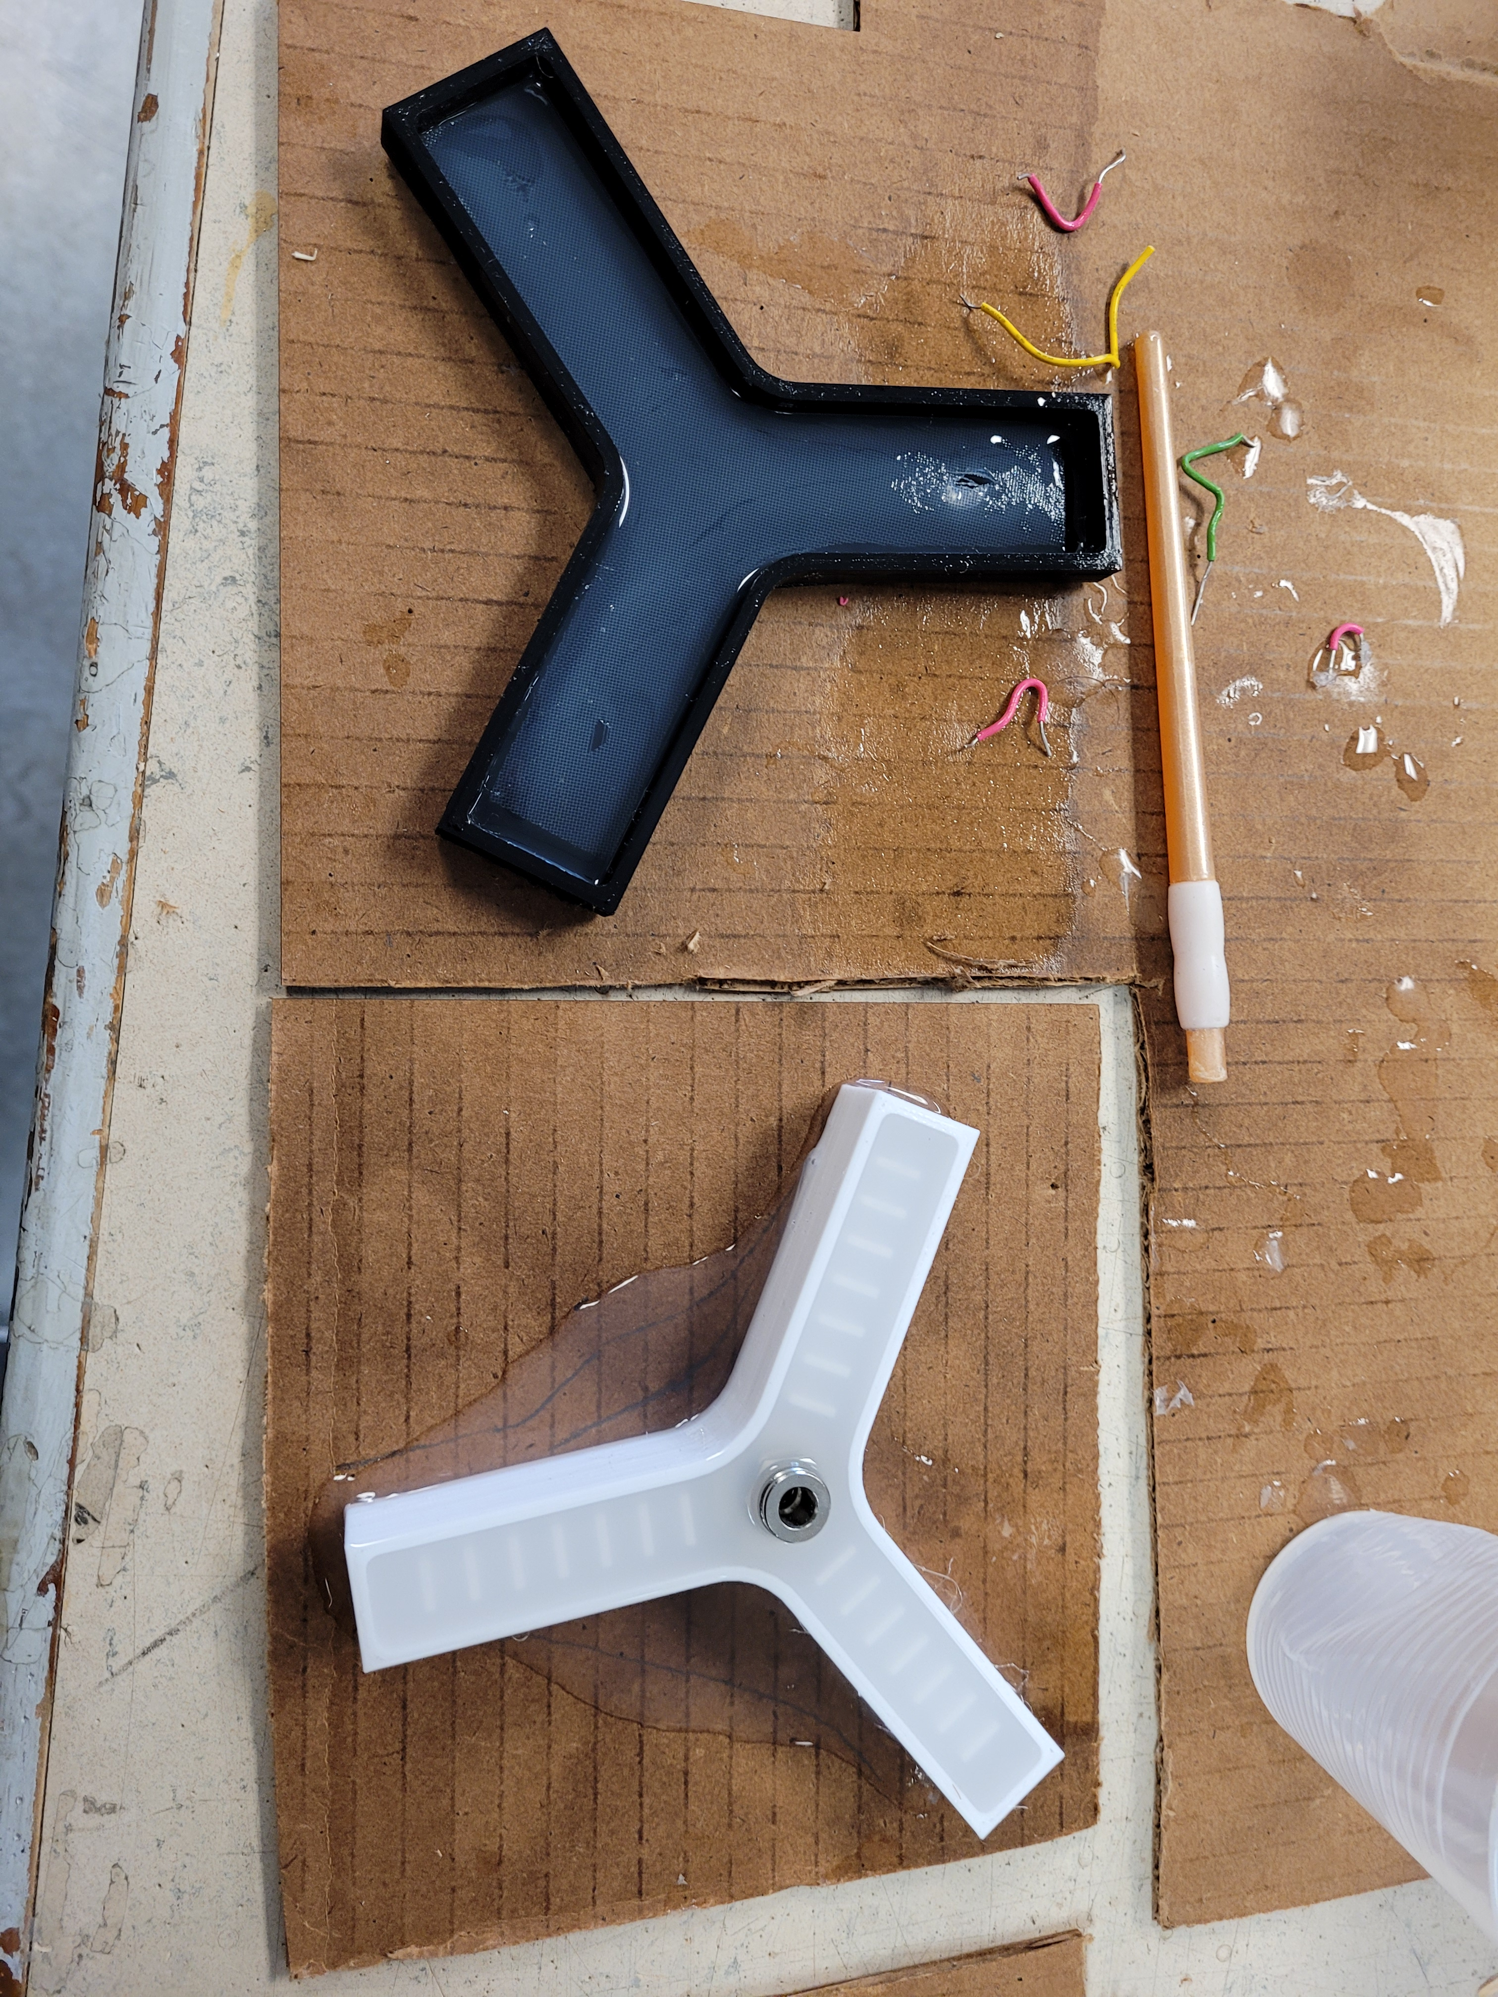
Making the Actuator

Slide 7
The Epic of the Actuator
What worked
Splitting the top mold into two pieces
Degassing silicone before pouring
Punching holes in the bottom of the paper
Using a quick connector with a washer
Partially curing silicone in oven
What didn’t worked
Using mesh instead of paper
Trying to bond silicone to anything that was not silicone
Punching to many holes in the bottom of the paper

Slide 8
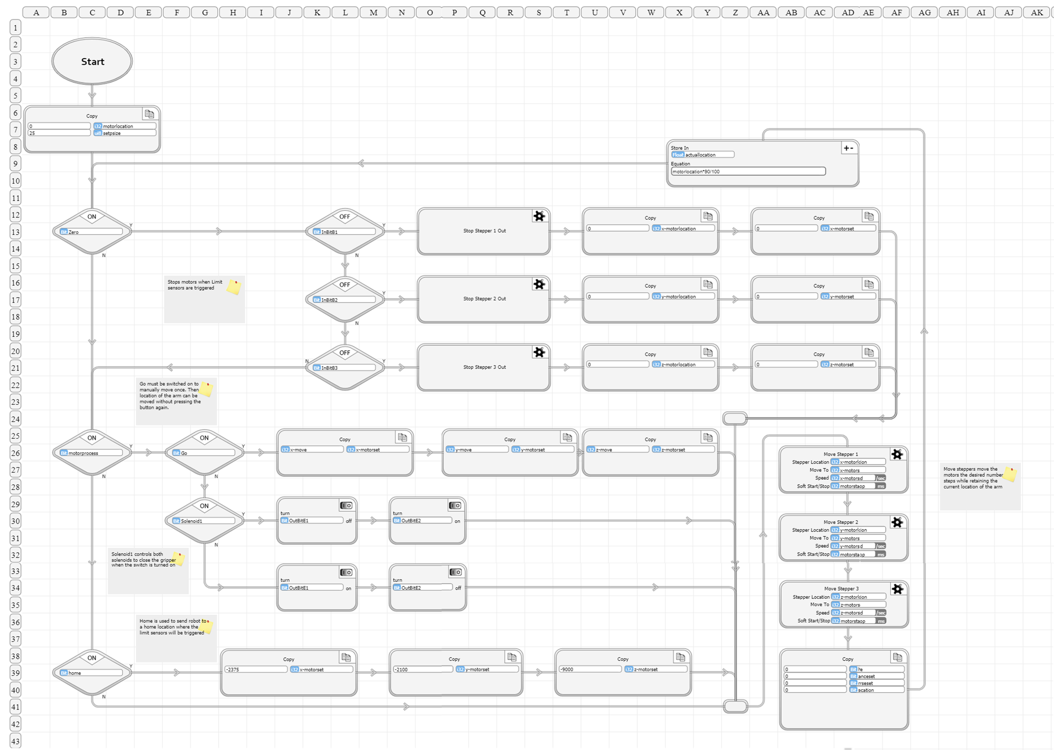
Code for Manual Control

